Slide 1



WHATSAPP CLONE

Slide 2

Submitted by:-
WHATSAPP CLONE
Submitted to:-
Mr. Mayank Saxena Technical Trainer GLAU CSE Department
Piyush Singh(201500472)
Bed Prakash(201500189)
Kabeer Saxena(201500321)
Ujjwal Gupta(201500751)

Slide 3
Technologies used:-
Technologies that we have learnt so far are as follows:-
HTML
CSS
JavaScript
Node.js
React.js
MongoDB

Slide 4

HTML
HTML is an acronym which stands for Hyper Text Markup Language which is used for creating web pages and web applications.
HTML describes the structure of a web page.
HTML consists of a series of elements.
HTML elements tell the browser how to display the content.
HTML elements label pieces of content such as “this is heading” , ”this is a
paragraph” , “this is a link” , etc.
A simple HTML Document:-
<!DOCTYPE html>
<html>
<head>
<title>WEB DEVELOPMENT</title>
</head>
<body>
<h1>Heading</h1>
<p>Paragraph</p>
</body>
</html>

Slide 5
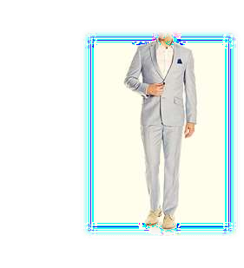
CSS
CSS stands for Cascading Style Sheets.
CSS describes how HTML elements are to be displayed on screen, paper, or in other
media.
CSS is used to define styles for our web pages, including the design, layout and variations in display for different devices and screen sizes.
The word cascading means that a style applied to a parent element will also apply to all the children elements within the parent. So if we set the color of the body text to “blue”, all headings , paragraphs and other text elements within the body will also get the same color(unless we specify something else).
CSS can be added to HTML document in 3 ways:-
INLINE:-by using the style attribute inside html elements.
INTERNAL:-by using a <style> element is <head> section.
EXTERNAL:-by using a <link> element to link to an External CSS file.

Slide 6

JavaScript
JavaScript is a programming language that is one of the core technologies of the
World Wide Web, alongside HTML & CSS.
JavaScript is used to create dynamic and interactive web content like
applications and browsers.
Some examples of JavaScript applications:-
Web And Mobile Apps
Game Development
Server Applications

Slide 7

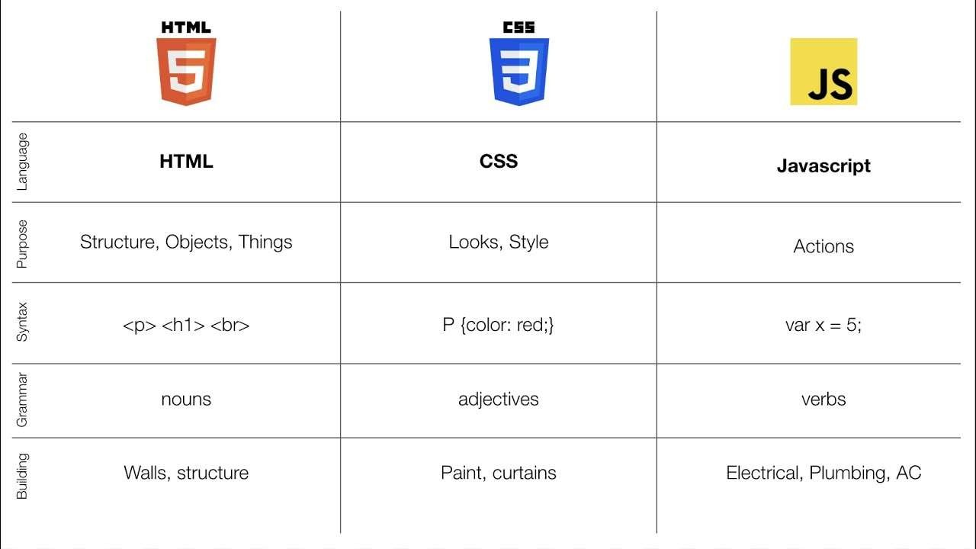
Difference-

Slide 8
Bootstrap
Bootstrap is a free front-end framework for faster and easier web development.
Bootstrap includes HTML and CSS based design templates for typography , forms , buttons , tables , navigation models , image carousels and may other, as well as optional JavaScript plugins.
Bootstrap also gives us the ability to easily creative responsive designs.
Responsive web design is about creating websites which automatically adjust
themselves to look good on all devices, from small phones to large desktop.
Advantages of Bootstrap:-
Easy to use
Responsive features
Mobile-first approach
Browsers Compatibility

Slide 9
Node.js
Node.js is an open-source, cross-platform, JavaScript runtime environment that executes JavaScript code outside of a web browser. It is built on top of the V8 JavaScript engine, which is also used in Google Chrome. Node.js allows developers to write server-side code using JavaScript, which is a popular programming language for web development on the client-side.
Node.js provides an event-driven architecture and a non-blocking I/O model, which allows it to handle large amounts of data and simultaneous connections efficiently. This makes it particularly well-suited for building scalable network applications, such as web servers, real-time chat applications, and streaming services.

Slide 10
Project Details:-
Project Name:-WhatsApp Clone
Language Used:- HTML,CSS, React.js, MongoDB
User Interface Designs:-HTML ,CSS ,Node.js, Express.js
Web Application:-WhatsApp Services
Tool Used:-VS Code
Server:-Localhost and Live server of VS Code

Slide 11
PROJECT IDEA
A WhatsApp clone project would be an excellent way to practice your programming skills and learn how to build a messaging app. Here are some ideas for how you could approach the project
Chatbot: You can develop a chatbot for WhatsApp that can answer commonly asked questions or perform certain tasks, such as making reservations or placing orders.
Language translation: Create a WhatsApp add-on that can translate messages in real-time, allowing users to communicate with people who speak different languages.

Slide 12
THE CLONE
The App includes all the services use clients like messaging and calling Everything can be accessed with only one single tap.
This App is providing services to sending message , voice call , video call etc. All the services provide one must have to be a game changer.
This Clone is developed using HTML, CSS, React.js, Node.js, MongoDB.

Slide 13
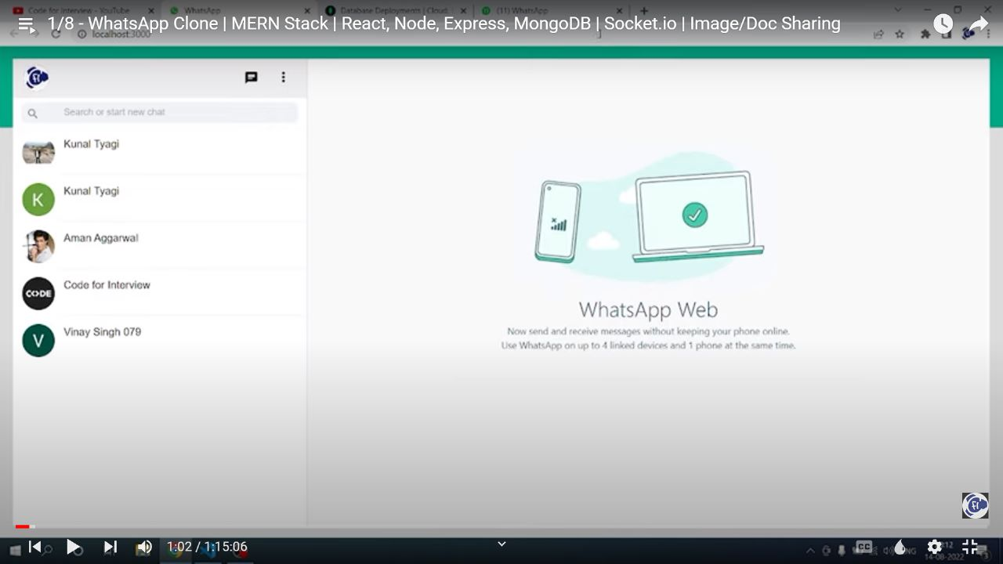
HOME PAGE
▶ The first impression is the last. This line should be the foundation of your homepage. Home page is the first thing customers see when they land on your App and you don’t want to go wrong with that. This is the place to capture their attention, and they decide if they wish to delve into the other pages.
▶ A homepage should be rife with details yet simple. Color schemes, images, font, tone—every element affects the
customer’s subconscious thinking. The page should be clutter-free, inviting, and pleasing to the eyes.

Slide 14
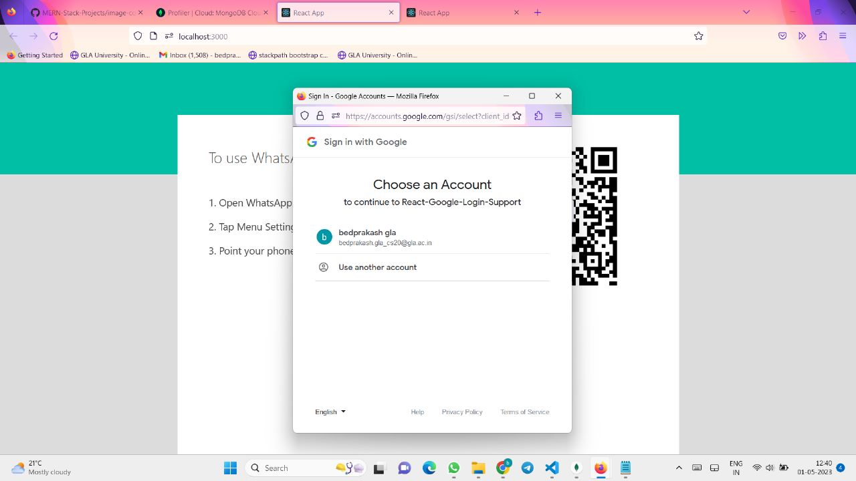
SIGN-UP PAGE
▶ The sign-up page has features like full name, email , username, password.
▶ The user can create an account by giving their full name, email id , username, password.
▶ Once the Signup button is clicked, the user credentials will get stored.

Slide 15
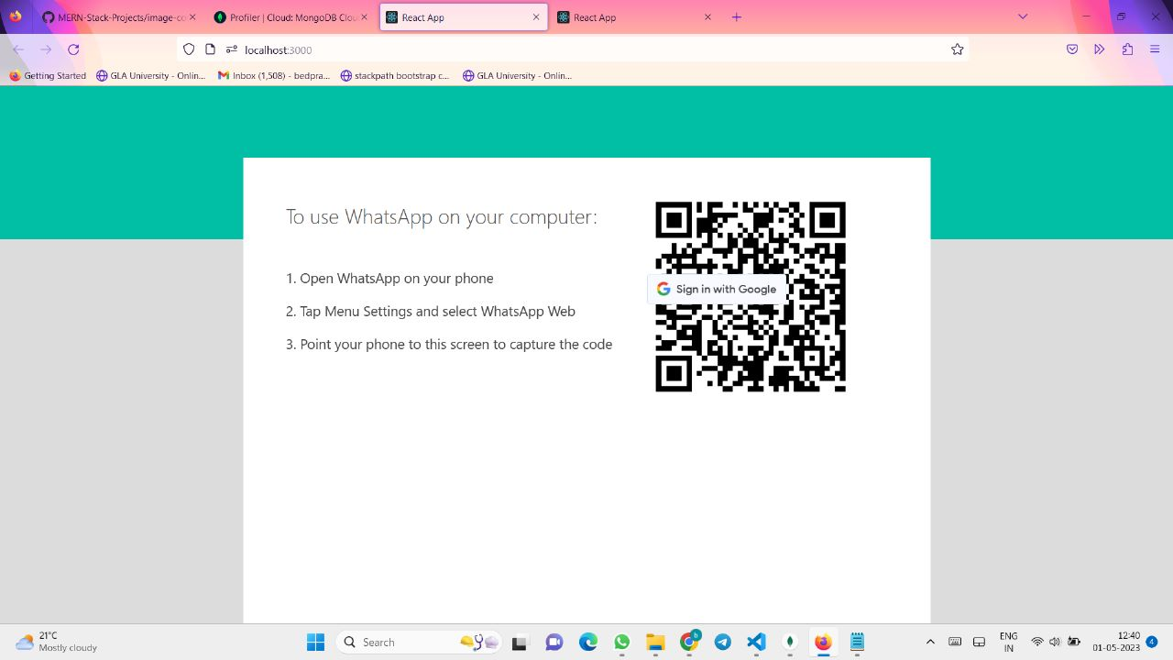
LOGIN PAGE
LOGIN PAGE
▶ In this page, the user can login to the website using their respective Mobile number and OTP.
▶ On clicking the login, the application will authenticate the user with the credentials stored.

Slide 16
Features-
A WhatsApp clone project would be an excellent way to practice your programming skills and learn how to build a messaging app. Here are some ideas for how you could approach the project
Choose a programming language and framework: You could use popular programming languages like Java, Swift, or JavaScript and use frameworks like React Native, Flutter, or Angular to build the front-end of the app.

Slide 17
1. Authentication: You will need to implement a secure authentication system for users to sign up and log in to your app. You could use a third-party authentication service like Firebase Authentication to simplify the process. 2.Messaging: The core functionality of a messaging app is messaging, and you will need to implement real-time messaging between users. You could use web sockets or a messaging API to implement this feature. 3.Group Chats: Group chats are an essential feature of messaging apps. You will need to allow users to create groups, invite other users to join them, and send messages to the group.
Clone

Slide 18
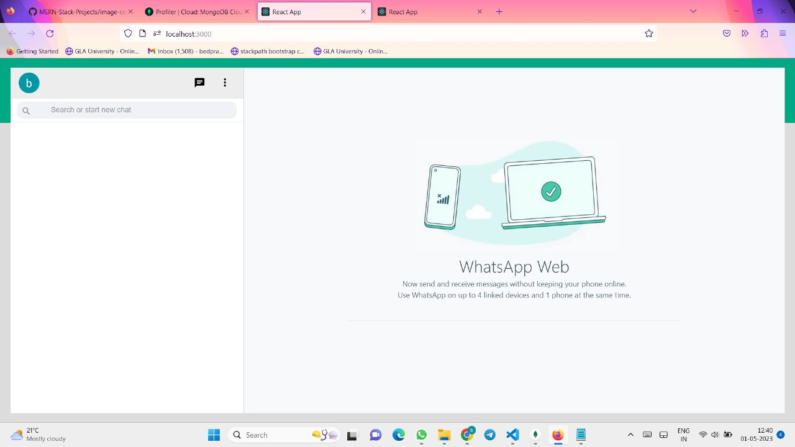
This page showcases the WhatsApp Clone that have been in demand in past week. The user will know the trendiest style by looking at this page which will gain their interest and they can sending message and video call the single tap.
Features

Slide 19
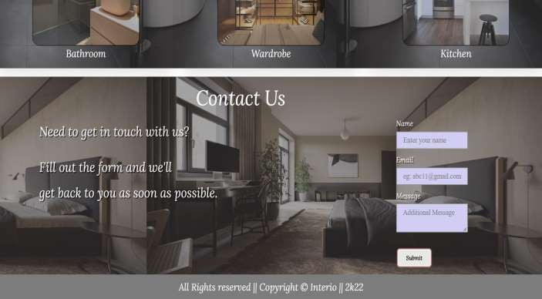
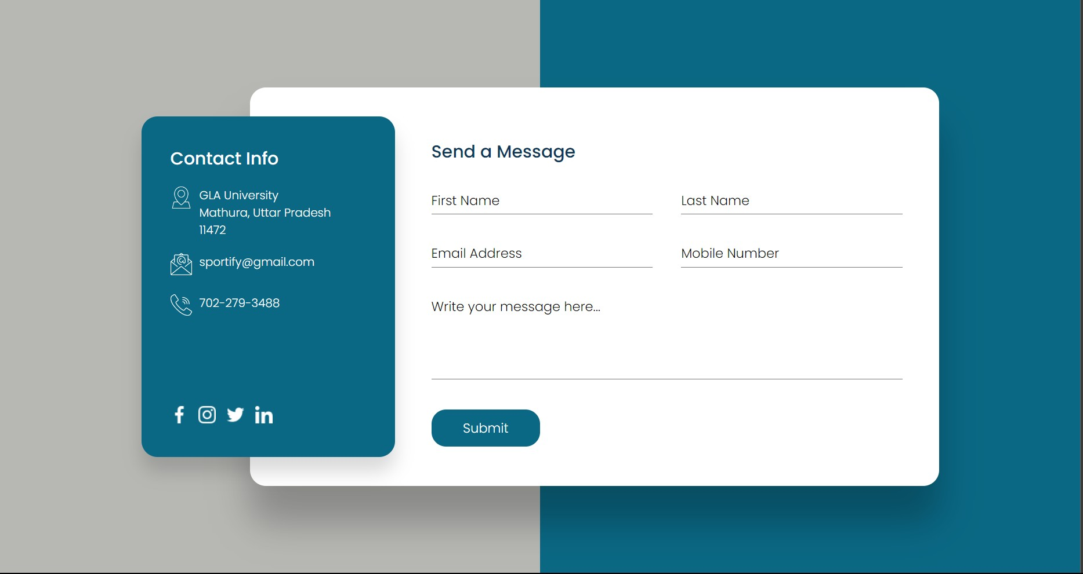
CONTACT PAGE
▶ The user can contact the author of the Clone using this contact form.
▶ The user can enter his Name, email address along with the body of message.
▶ After entering the data in the contact form, when the user click the submit button, the email will be sent to the author.

Slide 20


THANKYOU

